Slide 1
TNE20002 / TNE70003
PPP and CHAP V1.1

Slide 2
PPP – Point to Point Protocol

Slide 3
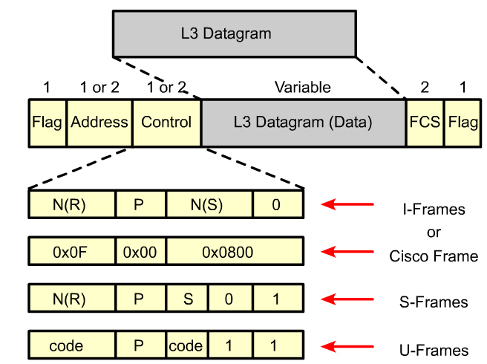
HDLC Encapsulation 1979
In 1979, the ISO agreed on HDLC as a standard bit-oriented data link layer protocol that encapsulates data on synchronous serial data links.
Since 1981, ITU-T has developed a series of HDLC derivative protocols.
The following examples of derivative protocols are called link access protocols:
Link Access Procedure, Balanced (LAPB) for X.25
Link Access Procedure on the D channel (LAPD) for ISDN
Link Access Procedure for Modems (LAPM) and PPP for modems < -------------
Link Access Procedure for Frame Relay (LAPF) for Frame Relay

Slide 4
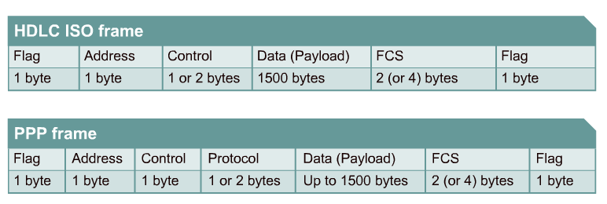
HDLC and PPP Encapsulation
HDLC is the default Layer 2 protocol for Cisco router serial interfaces
HDLC does not have a way to indicate which layer 3 protocol is being carried.
PPP frame has a Protocol field that indicates it is carrying either a layer 3 IPV4 packet or IPV6 packet

Slide 5
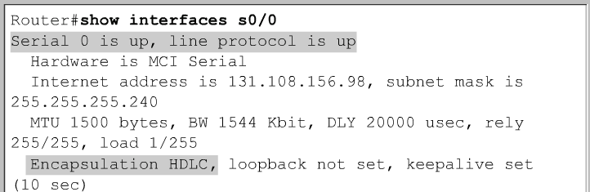
Configuring HDLC
The default encapsulation method used by Cisco devices on synchronous serial lines is Cisco HDLC.

Slide 6
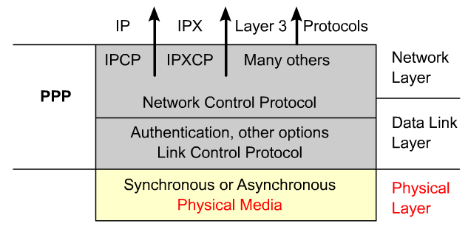
PPP layered architecture
PPP contains two sub-protocols:
Network Control Protocol
Encapsulate and negotiate options for multiple network layer protocols
Responsible for configuring, enabling and disabling the network layer protocol
Link Control Protocol
Negotiate and setup control options on the WAN data link.
The LCP sits on top of the physical layer and is used to establish, configure, and test the data link connection.

Slide 7
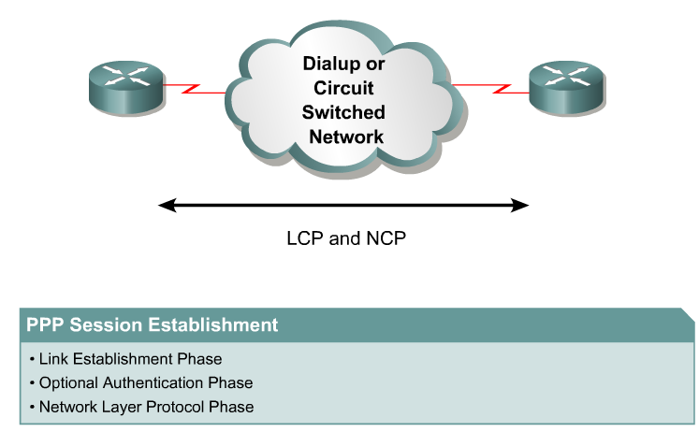
PPP Session Establishment – 3 Phases
Authentication/Link Quality Phase

Slide 8
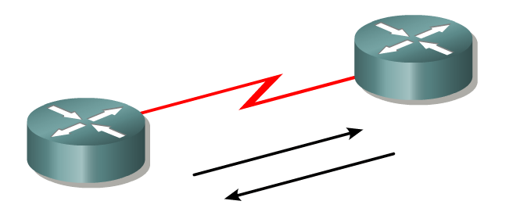
Phase 1 – Link establishment
In this phase each PPP device sends LCP frames to configure and test the data link.
LCP frames contain a configuration option field that allows devices to negotiate the use of options such as:
the maximum transmission unit (MTU),
compression of certain PPP fields,
the link-authentication protocol.
Before any network layer packets can be exchanged, LCP must first open the connection and negotiate the configuration parameters.
This phase is complete when a configuration ACK frame has been sent and received.

Slide 9
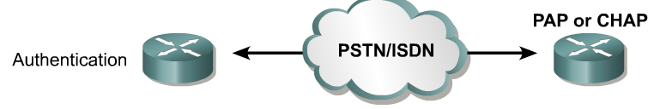
Phase 2 - Authentication | Link Quality
Gateway
ISP
Serial Link
After the link has been established and the CHAP authentication protocol decided on, the peer will be authenticated.
Authentication, if used, takes place before the network layer protocol phase is entered.
As part of this phase, LCP also allows for an optional link quality determination test.
The link is tested to determine whether the link quality is good enough to bring up network layer protocols

Slide 10
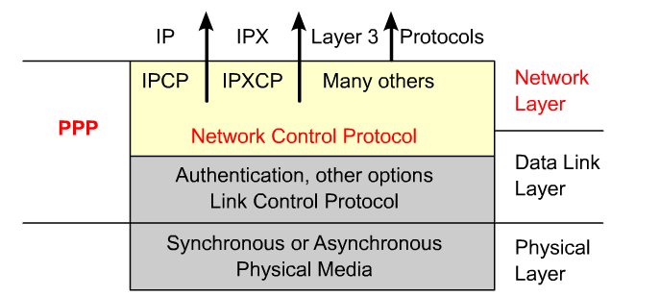
Phase 3 - Network Layer Protocol
In this phase the PPP devices send NCP frames to choose either the IPv4 or IPv6 network layer protocol.
When the network layer protocol has been configured, packets can be sent over the link.
The show interfaces command reveals the LCP and NCP states under PPP configuration.
The PPP link remains configured for communications until LCP or NCP frames close the link or until an inactivity timer expires or a user intervenes.

Slide 11
CHAP Challenge Handshake Authentication Protocol

Slide 12
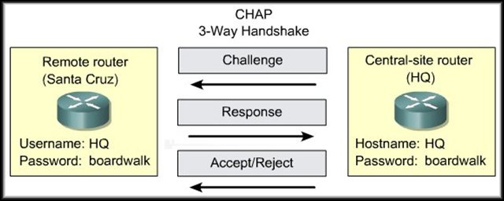
Challenge Handshake Authentication Protocol - CHAP
SantaCruz
CHAP is used at the startup of a link and periodically verifies the identity of the remote Host using a three-way handshake.
After the PPP link establishment phase is complete, the local router sends a "challenge" message to the remote Host.
The remote Host responds with a value calculated using a one-way hash function, which is typically Message Digest 5 (MD5).
This response is based on the password and challenge message.
The local Host checks the response against its own calculation of the expected hash value.
If the values match, the authentication is acknowledged, otherwise the connection is immediately terminated.

Slide 13
Challenge Handshake Authentication Protocol (CHAP)
CHAP provides protection against playback (relay) attack through the use of a variable challenge value that is unique and unpredictable.
Playback attack: A breach of security in which information is stored without authorization and then retransmitted to trick the receiver into unauthorized operations such as false identification or authentication or a duplicate transaction.
Since the challenge is unique and random, the resulting hash value will also be unique and random.
The local host or a third-party authentication server is in control of the frequency and timing of the challenges.

Slide 14
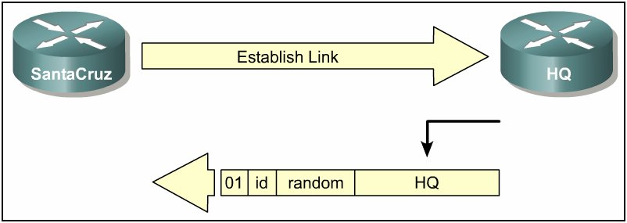
1. PPP Authentication – SantaCruz calls HQ
Challenge
SantaCruz calls HQ to establish a PPP link.
HQ router sends a CHAP challenge packet with the following details:
01 = challenge packet type identifier.
ID = sequential number that identifies the challenge.
random = a random value generated by the HQ router.
HQ = the authentication name of the challenger.

Slide 15
2. HQ CHAP Challenge sent to SantaCruz
Challenge
The challenge packet is sent to the calling (SantaCruz) router.
The ID and random values are kept in a table on the HQ router.
A list of outstanding challenges is maintained in table on HQ router.

Slide 16
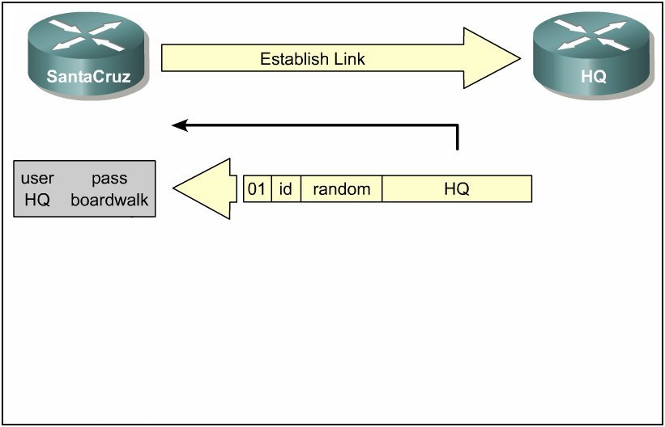
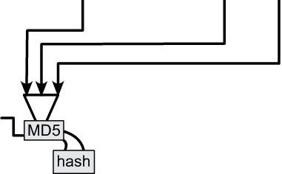
3.SantaCruz receives CHAP Challenge
Receive CHAP Challenge
Table of User/Password
The name HQ is used to look up the password.
The ID value, the random value and the password are fed into the MD5 hash generator.
The result is the one-way MD5-hashed CHAP challenge that will be sent back in the CHAP response.

Slide 17
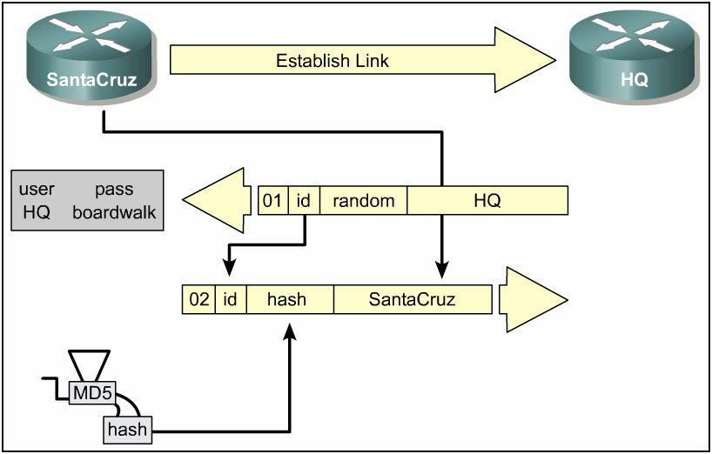
4.SantaCruz sends CHAP Response
The response packet is assembled and sent.
02 = CHAP response packet type identifier.
ID = copied from the challenge packet.
hash = the output from the MD5 hash generator.
SantaCruz = the hostname of the responding device.

Slide 18
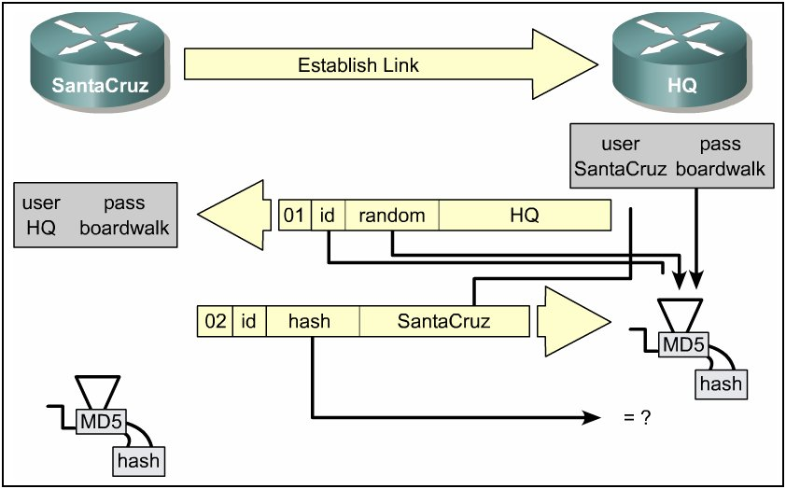
5. HQ receives CHAP Response
The ID is used to find the original challenge packet in table.
The name is used to look up the password from a configured name or a security server.
The original ID, the original random value and the password are fed into the MD5 hash generator.

Slide 19
6. HQ Compares
Receive CHAP Response
The hash value received in the response packet from SantaCruz is then compared with the MD5 hash value calculated by HQ.
CHAP authentication succeeds if the calculated and the received hash values are equal.

Slide 20
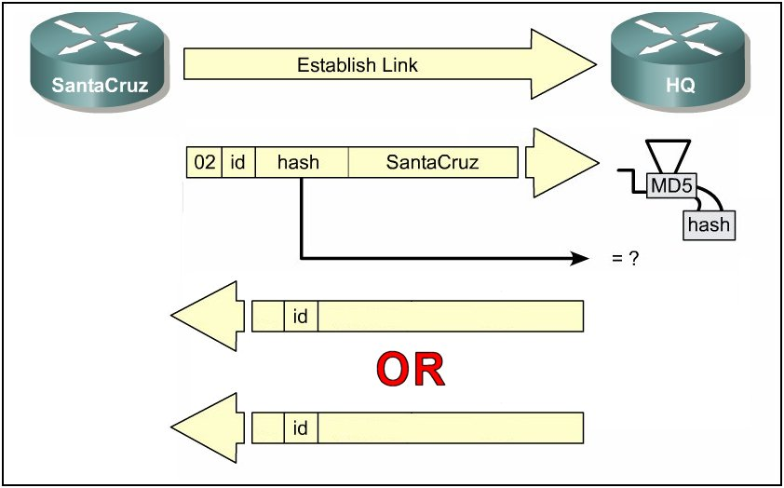
CHAP Challenge
Success OR Failure
03
Welcome In
If authentication is successful, a CHAP success packet is built from the following components:
03 = CHAP success message type.
ID = copied from the response packet.
“Welcome In” is simply a text message providing a user-readable explanation.

Slide 21
CHAP Challenge
Success OR Failure
Welcome In
03
Welcome In
03
Authentication Failed
04
If authentication fails, a CHAP failure packet is built from the following components:
04 = CHAP failure message type.
ID = copied from the response packet.
“Authentication failure” or other text message, providing a user-readable explanation.

Slide 22


Configuring CHAP
username HQ password cisco
interface Serial0
ip address 172.25.3.2 255.255.255.0
encapsulation ppp
ppp authentication chap
username SantaCruz password cisco
interface Serial0
ip address 172.25.3.1 255.255.255.0
encapsulation ppp
ppp authentication chap

Slide 23
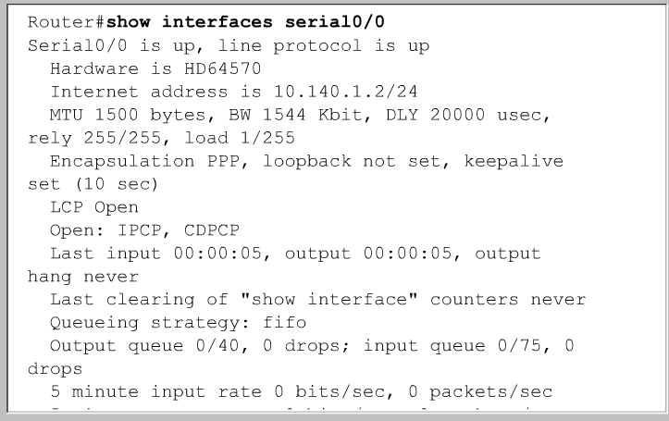
Verifying PPP
LCP
NCP

Slide 24
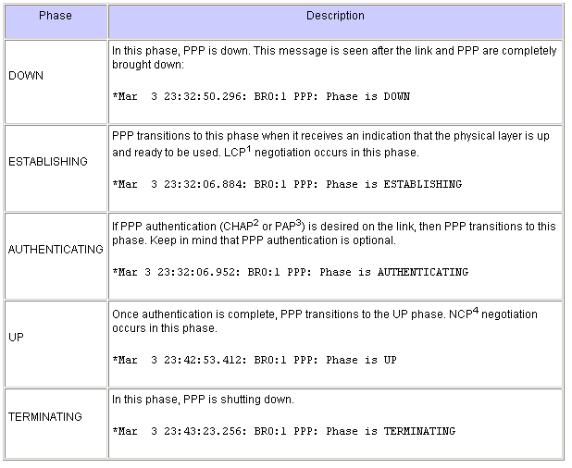
debug ppp negotiation
Router#debug ppp negotiation
PPP protocol negotiation debugging is on
. . .
BR0:1 LCP: State is Open
. . .
PPP: Phase is AUTHENTICATING
. . .
BR0:1 IPCP: State is Open
. . .
The debug ppp negotiation command enables you to view the PPP negotiation transactions, identify the problem or stage when the error occurs, and develop a resolution.
During PPP negotiation, the link goes through several phases, as shown above.
The end result is that PPP is either up or down.

Slide 25
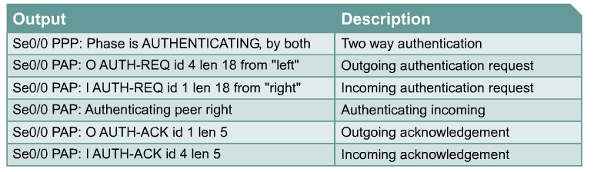
debug ppp authentication
The debug ppp authentication command displays the authentication exchange sequence.
With two-way authentication configured, each router authenticates the other.
Messages appear for both the authenticating process and the process of being authenticated.

Slide 26
The End
PAP, CHAP, and MS-CHAP - CompTIA Security+ SY0-501 - 4.2 - YouTube
1. Intro to the Point to Point Protocol PPP - YouTube

